Slide 1
Capstone Presentation
Flight Price Prediction
Nitin Yadav
PGB BABI – April Batch

Slide 2
Table of Content
Business Problem
Need of study
Understanding business/social opportunity
Data understanding
EDA Report and Insights
Feature Engineering on variables (Outlier, NA, Encoding)
Hypothesis Testing
Model Building and Interpretation
Linear Regression , Ridge , Lasso and Elastic Net
KNN Regressor
Tree Based Regressor Models (Cart)
Ensemble Models ( Random Forest , GBM and XGBoost)
Final Result
Conclusion and Future Recommendation

Slide 3
Business Problem
1
Airline Industry Nature -
Working on very thin margins
Business is very dynamic considering demand and supply
Price varies depending on search criteria , seat availability , date/time
Right Price prediction mechanism is very important to get adequate customer and profitable business using predictive analytics
Flight Price Prediction - Nitin Yadav

Slide 4
Need of Study and Business Opportunity
2
3
Type of Problem – Machine Learning
2 Data sets - Train (10683) and Test (2671) records
Business Opportunity –
Right Price of flight can make or break the airline industry business
Enables customer to take right decision
Applicability of supervised machine learning technique to train the data
Train data set has response (Price) and other independent variable as predictors
Build prediction mechanism on Test data to predict fare prices
Better Machine Learning model would ensure accuracy and minimum error

Slide 5
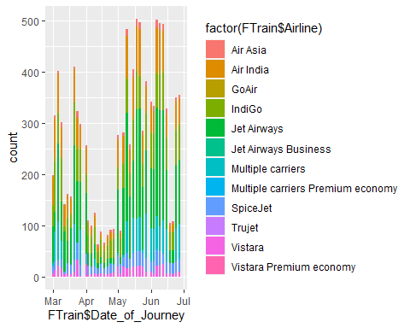
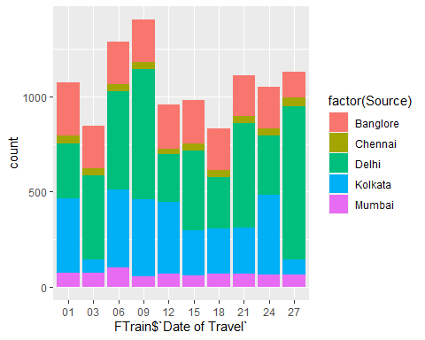
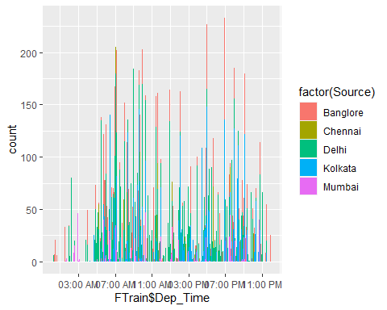
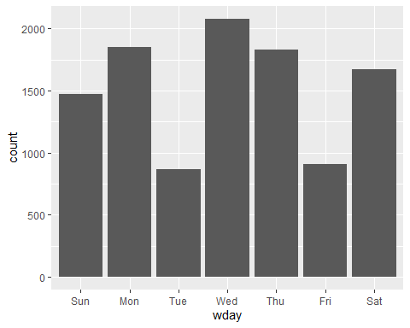
Data Understanding , EDA & Insights
4
Data Collection
4 Months data from March till June
Data provided for weekday, weekends and 24 hours timescale
Visual Inspection
Price is dependent variable, all other variable are independent or predictors
Except Price which is numeric, all other variables are in “Char” format which needs to be converted to categorical or right class
Date of Journey column needs to be separated into “Date”, “Month” and “Year” columns and convert to Date format
Departure time and arrival time have to be converted to time format and the duration has to be put in either “Total hours” or “Total mins”. We have taken “Total Mins”
Minimum of duration (in mins) is 75 mins and maximum is 2860.
Flight Price Prediction - Nitin Yadav

Slide 6
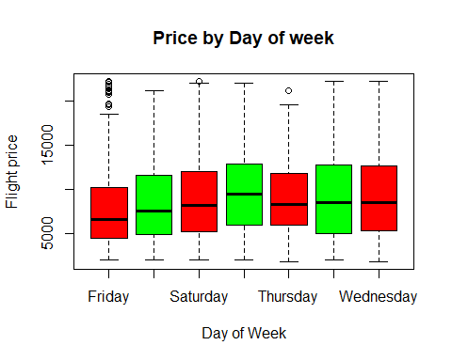
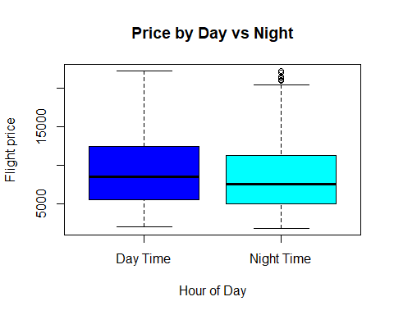
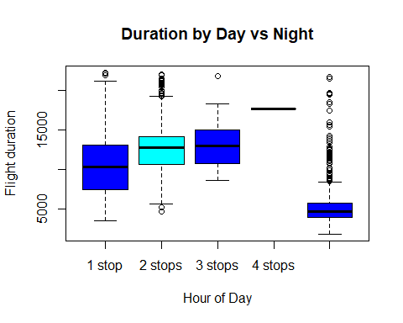
Data Understanding , EDA & Insights
4
Insights from Data
Jet Airways and Indigo have the maximum number of flights followed by Air India
Delhi, Kolkata and Bangalore have the maximum flights starting as Source City
Cochin, Bangalore and Delhi have the maximum flights Destination City
There are 3491 non-stop flights and 5625 flights with 1 stop.
There is a huge variation in the price , minimum is 1750 and maximum goes up to 79500. There are possibility of outliers in the Price column.
Dates within 1st to 10th of month have highest number of flights and maximum flight are in month of May-June (Possibility of Summer Holidays)
Skewness is a measure of symmetry , positive skewness for price (1.85) means the mean is more than median of the entries and hence it is right skewed

Slide 7
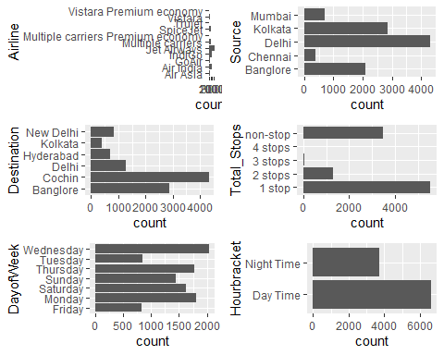
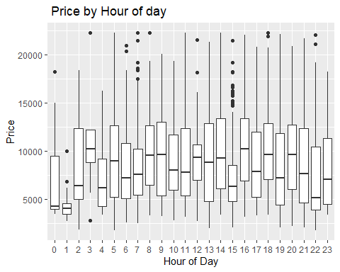
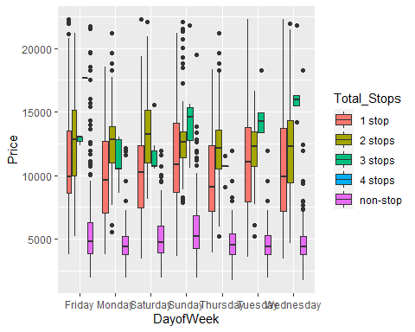
Data Understanding , EDA & Insights
4
Insights from Data contd….
Kurtosis define the tail shape of data distribution , in this we have excess kurtosis (13.5) which is towards positive hence it indicates Fat tailed distribution or leptokurtic
Day of Travel shows that maximum number of flights are on Monday , Wednesday and Thursday
Departure Time and arrival time shows that maximum number of flights arrive and depart around 7 pm in evening
Average flight price on Sunday and Friday are highest and on Monday are lowest
Price of Daytime flight is more than night time
Jet Airways, Air India and Indigo have highest number of flights in May June month which is maximum or peak season from flights perspective due to summer holiday season
Flight price and Flight duration in mins have a positive correlation of 0.56, means as duration increases flight price increases.
Flight Price Prediction - Nitin Yadav

Slide 8
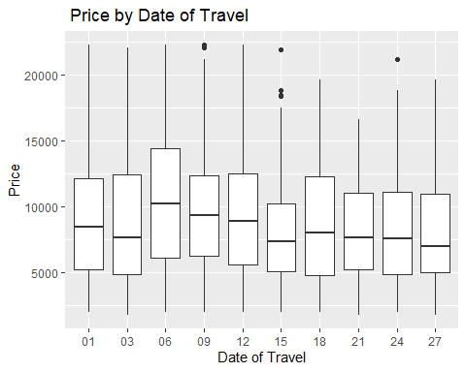
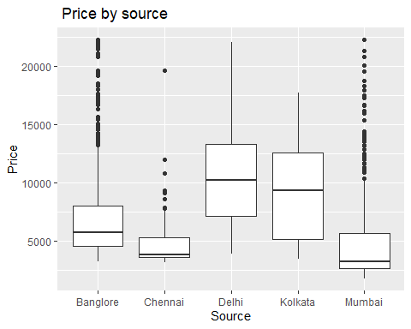
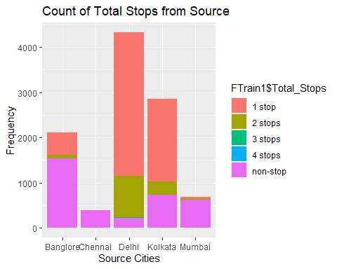
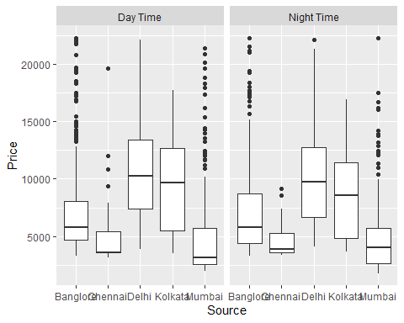
Hypothesis Testing and Feature Engg.
4
Hypothesis Testing – We did t-test and anova testing to conclude that
Flight prices on weekdays are cheaper than weekends
Flight price during peak hours (9am-9pm) are costly than non-peak hours
Feature Engineering
We did encoding and normalization to ensure that all the predictors are converted to numeric for regression model and also to remove any variance wrt. Observations
For Quantitative regression models ( encoding and normalization ) is done
For tree based algorithms , it is not the case hence we have taken the variable As-is for Tree based and ensemble techniques

Slide 9
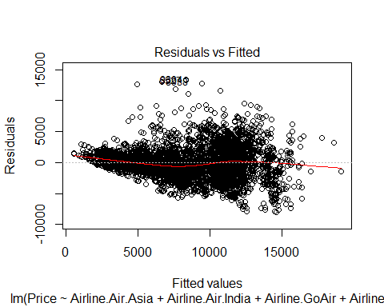
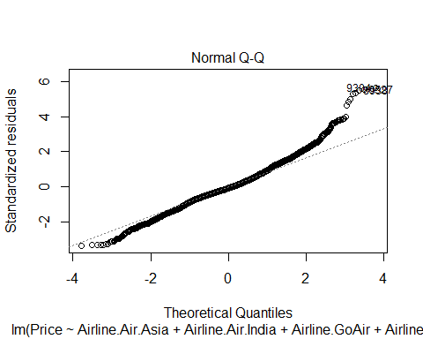
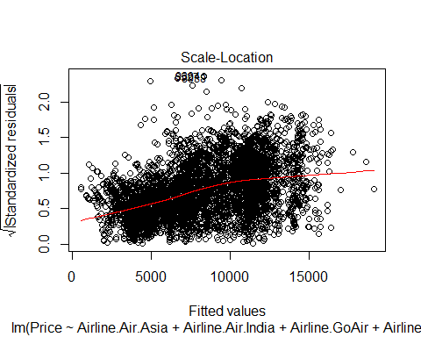
Model Building and Interpretation
5
Multiple Linear Regression
The intercept consider the effect of variables that we have not considered
R square interpretation - 63% of the variation in the flight price is explained by the independent variables used in the model
Adjusted R square shows the effect of adding more variables in the model. For e.g. current model is explained 63% by the independent variables which means remaining 40% of model is unexplained or by residuals.
Model metrics → RMSE – 2629.4 , R2 - .633

Slide 10
Model Building and Interpretation
5
Ridge , Lasso and Elastic Net
Normal regression works by selecting the coefficients that minimize the loss function, however if the coefficient are large there may be chance of overfitting the training data and will not generalize well on unseen test data .To overcome this we will do regularization that will impact the large coefficients
Ridge Regression - Loss function is minimized by adding a penalty parameter equivalent to square of magnitude of coefficients.
Lasso Regression - in this loss function is modified to minimize the complexity of model by limiting sum of absolute values of model coefficients
Elastic Net - It uses the properties of both ridge and lasso . It works by penalizing the model using both optimum alpha and lambda values. We use caret package to find optimal values and using the hyper tuning parameters
Model Metrics
Ridge → RMSE -2579 , R2-0.634
Lasso → RMSE -2626 , R2 -0.633
Elastic Net → RMSE -2627 , R2-0.633

Slide 11
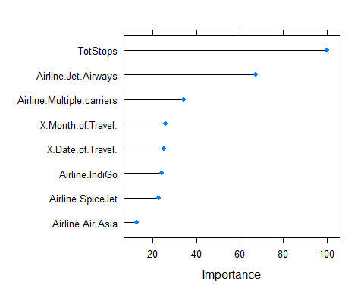
Model Building and Interpretation
5
Ridge , Lasso and Elastic Net contd…
We can clearly see that above numeric regression models are not fitting well on the train data as evident from RMSE and R2. There are lot of unexplained component which is not captured by model.
We will explore other Regression techniques like KNN and Tree based to see if there is improvement.

Slide 12
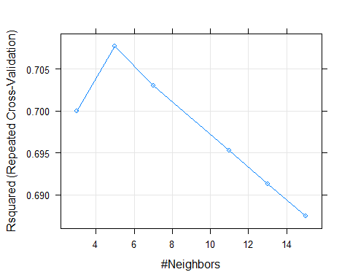
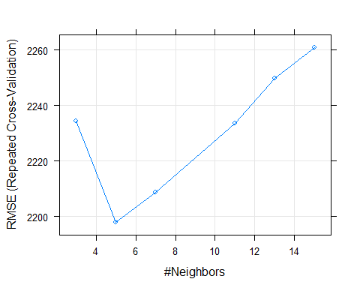
Model Building and Interpretation
5
KNN Regressor
KNN – Use Caret package to find the optimal number of nearest neighbors to predict the value. We used cross validation method where 9 samples were used for train and one is used for test
Minimum RMSE is achieved when K is 5 , we use both default method of RMSE and Rsquared method, and find out that Rsquare gives a slight better RMSE reduction
Model Metrics → RMSE – 2116, R2 - .73

Slide 13
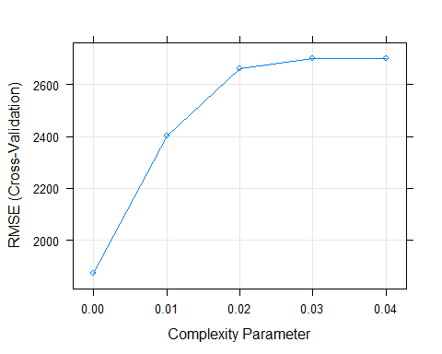
Model Building and Interpretation
5
Decision Tree
we split the tree starting from root node based on the condition that each split will have minimum impurity or less Gini index . Impure nodes will have more Gini index and have maximum variance
The split should be such that when we come from root node to child node the Gini gain is maximum for that particular split compared to other split for different predictors and Gini impurity reduces for that node compared to root node.
Decision Trees are powerful but have tendency to over fitting the data. We prune the tree to avoid overfitting based on complexity Parameter
Too many branches - chances of overfitting (capture of noise ) Too less branch - under fitting ( Misclassification error )
Model Metrics → RMSE - 1885.7 R2 -.787

Slide 14
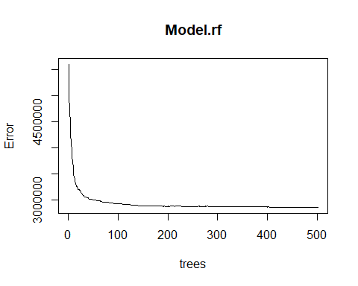
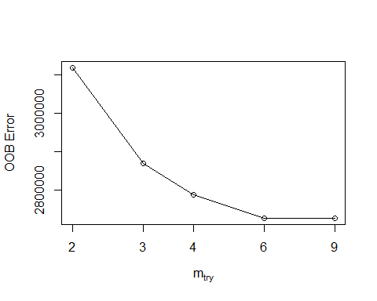
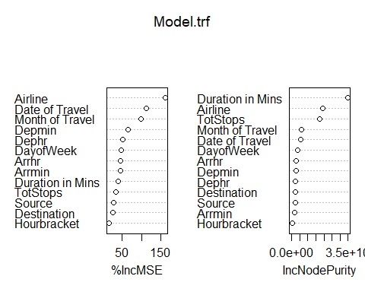
Model Building and Interpretation
5
Random Forest
This is an ensemble model technique in which we combine multiple models (Decision Tree in this case) to improve the predictive power of the model.
We use bootstrap aggregating (which is generating new training subset by sampling the data subset over and over again with replacement) Through this we ensure that the each tree built within the forest is diverse and at the same time share communality that they have been built from the same subset of data.
We have to be careful with value of m “mtry in mode”, if m is large variables become too correlated , if m is small, then predictive power of model decreases
Model Metric → RMSE - 1654.5 R2 - .836

Slide 15
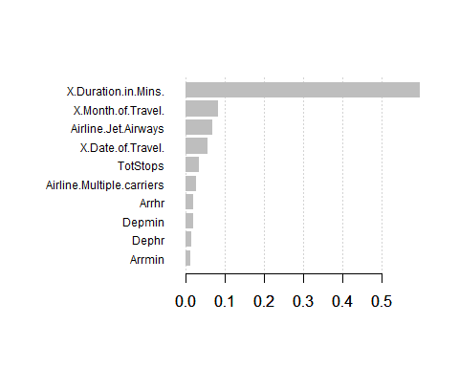
Model Building and Interpretation
5
Boosting method – Extreme Gradient Boosting
We will do boosting to sequentially train the weak learners. Difference in bagging and boosting is that bagging is parallel and boosting is sequential
Xgboost is specialized implementation of gradient boosting decision trees designed for performance
Advantages of Xgboost over other models –
Parallel computing - it is enabled with parallel processing
Regularization - it is used to avoid overfitting in linear and tree based models
Enabled cross validation - it is enabled with internal CV and not needed any additional package
Missing values - model can handle missing values
Tree pruning - it grows the tree upto a max depth and then prune backward until improvement in loss function.
Bias and Variance - Unlike bagging model like Random forest which takes care of overfitting (high variance) but still retains some bias, Boosting method can handle both bias and variance
Model Metric → RMSE - 1677 R2 - .832

Slide 16
Final Result and Conclusion
6
Feature Engineering is most crucial for these type of supervised machine learning problem
Although both Random forest and Xgboost gave similar result but we choose Xgboost for final model building considering it takes care of both bias and variance
The model accuracy can be further built by tuning the hyperparameters

Slide 17
Conclusion and Future Recommendation
7
Supervised machine learning technique can be a good predictor of airfare prices for historical data
The most important factors in airfare price prediction are the data collection (Type and nature of date) and the feature engineering (techniques to apply for model building)
Our finding suggest that the key important factors in pricing models are “Duration in mins” , “Total stops” , “Month of Travel”, Type of airline” etc. These are not limited to but can be extended to other variables which were missing like airline delay etc.
Large datasets collected over a longer duration and inclusion of other important predictors can increase the prediction accuracy of model.

